Slide 1
Software Quality Engineering
MANAGING SOFTWARE QUALITY IN AN ORGANIZATION
Quality Management System QMS
By
Dr. Sumaira Nazir

Slide 2
Quality Management System
Quality Management System (QMS)
Term used internationally
Describe a process which ensures and demonstrates the quality of the products and services provided by an organization.
Set of Procedures/Processes which form basis for executing organization’s product/service delivery mechanisms.

Slide 3
Quality Management System Cont..
Term “Quality System” sometimes used instead of Quality Management System
ISO 9001:2000 specifies requirements for QMS
Needs to demonstrate its ability to consistently provide the product that meets customer and applicable regulatory requirements and
Aims to enhance customer satisfaction through the effective application of the system, including processes for continual improvement of the system and the assurance of conformity to customer and applicable regulatory requirements.

Slide 4
Quality Management System Cont..
The quality management system(QMS) in an organization emphasizes on the need of the quality process to be actively managed to ensure that it continues to be effective and efficient.
By keeping their Practices and Tools under constant review and make change in controlled way.
This helps to ensure that the QMS is effective in the face of continuously changing business environment.

Slide 5
Quality Management System Cont..
In the QMS employees need to be properly trained (awareness) to use QMS (Training plays important part in quality related activities)
Quality Professional should have mindset and skills for imparting training within his area of responsibility
QMS must ensure that employees
have the right skills to do their jobs professionally (If not, then train them)
understand their responsibilities and how their work relates to others.

Slide 6
Quality Management System Cont..
Successful QMS gives great emphasis to early corrective action
Much cheaper for software developer to correct errors early in development life cycle.
Error might cost the customer much more than it costs the developer.
Quality Control activities (Inspection) to be built at every stage to detect errors as early as possible before moving to next stage
Find root cause of an error and make action plan to prevent it (Root Cause Analysis).

Slide 7
Quality Management System Cont..
QMS must assure customer and developers that software products and services developed by adhering to the QMS will be of good quality.
QMS should be auditable
Development process must be well documented.
Quality records including suitable measurements must be generated throughout software development process.

Slide 8
Quality Management System Cont..
Quality Record is a record kept as a part of QMS.
Quality Record:
Is a document which furnishes objective evidence of activities performed or result achieved.
For example; Review Record of Project Plan, Code Review Results, Test Execution Report etc
Helps demonstrate the achievement of quality and effective operation of QMS.

Slide 9
Quality Management System Cont..
ISO 9001:2000 General requirements from QMS
Organization shall
Establish, Document, Implement and Maintain a QMS
And Continually improve effectiveness of QMS

Slide 10
Quality Management System Cont..
In particular, ISO requires that the organization shall
Identify the processes needed for the quality management system and their application throughout the organization
Determine the sequence and interaction of these processes.
Determine criteria and methods needed to ensure that both the operation and control of these processes are effective.
Ensure the availability of recourses and information necessary to support the operation and monitoring of these processes.
Monitor, measure and analyze these processes, and
Implement actions necessary to achieve planned results and continual improvement of these processes.

Slide 11
Quality Management System Cont..
QMS is a set of Procedures
Procedures are at the heart of Quality System
They tell staff how to follow a Quality System day to day in their work
QMS is a Management’s means to establish a uniform and consistent approach to product realization/providing services
QMS is a Complete Work Process
Including Policies, Procedures, Tools and Resources

Slide 12
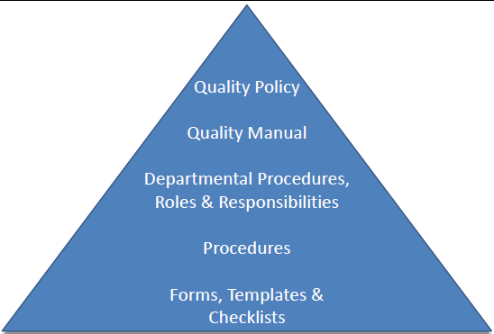
Quality Management System Cont..

Slide 13
Quality Policy
A document that states the overall intensions and direction of an organization with regard to quality as formally expressed by top management
Top Management should begin quality program by forming a Quality Policy
Should be a clear statement of
Organization’s commitment to quality
Management expectations of Quality Program
It should be published and communicated to the employees so that it is understood and implemented at all levels in organization.

Slide 14
Quality Policy Cont…
Clause 5.3 of ISO 9001:2000
Top Management shall ensure that quality policy
Is appropriate to the purpose of organization (Suitable for the business conducted by organization)
Includes a commitment to comply with requirements and to continually improve the effectiveness of the QMS
Provides a framework for establishing and reviewing quality objectives
Is communicated and understood within organization
Is reviewed for continuing suitability

Slide 15
Quality Manual
Begins with Vision and Mission Statement of organization, committing itself to Quality.
The quality manual begins with the Vision statement. Vision statement is followed by the Mission statement.
Vision Statement:
Vision statement defines the vision of the organization
For Example:
“To be the leader and most respected e-Solutions Company in Pakistan” OR
“Providing best of the breed CRM solutions to our customers”

Slide 16
Quality Manual Cont…
Mission Statement:
The mission statement extends the vision of the organization
For Example:
We are in the business of Providing Value to our customer through CRM solutions with commitment to quality of solutions providing. Making our organization a winner in the Global e-Business Market with solutions that are cost effective and with requisite quality”

Slide 17
Quality Manual Cont…
The typical contents of the quality manual are as follows:
Introduction (Purpose, Definitions, References)
Organizational structure – various roles for software delivery Project Management structure, structure of the quality group along with the descriptions of various sub-groups within it such as
Process Engineering Group (PEG)
Software Quality Assurance (SQA)
Measurement Assurance (MA)
Defect Prevention (DP)
Technology Change Management Group (TCMG)
Quality System Requirements (Quality Policy, Quality System Procedures, Approach to Quality Planning along with Quality Objectives)
Software product/services realization mechanism deployed in the organization.

